Slide 1
User Authentication using Mouse Dynamics
Bandaru Sai Manoj(17EC35007)
D Rajesh(17EC35037)
Daiveek Sai P(17EC10011)
M Vamsi Krishna(17EC10029)
K Sudheer Kumar(17EC35038)

Slide 2
Introduction and Motivation:
In today’s world security is the main concern ,so Personal recognition systems gained high interest.
We have some security systems but we need more reliable systems so that it is immune to theft or loss.
Biometrics are the personal physiological and behavioral characteristics which are mostly used for personal recognition.
Today Biometric based security systems are used everywhere especially in high security areas.
In this we present a new system i.e Mouse dynamics technique which is based on the human computer interaction.

Slide 3
Problem Statement: To authenticate the user by training and testing the Gaussian Mixture Model by the Mouse Dynamics data.
Acquire Continuous Mouse Dynamics data: The data collection process involves running a jar file which collects the continuous data of mouse dynamics and store it in a text file.
Recognise the user using the data: Gaussian Mixture is implemented to differentiate between and authenticate the user.
Apply Five Fold Validation to report results: The accuracy of correct authentication of the user is reported.

Slide 4

Architecture:

Slide 5
Raw Data
Mouse strokes are analysed for detecting patterns in authentication systems.
Mouse stroke is a set of points between two clicks.
The data contains
Mouse Move
Mouse Drag
Mouse Pressed
Mouse Released
Mouse Clicked
The processing of the above data is analysed to create features which are input to the classifier.

Slide 6
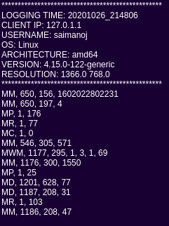
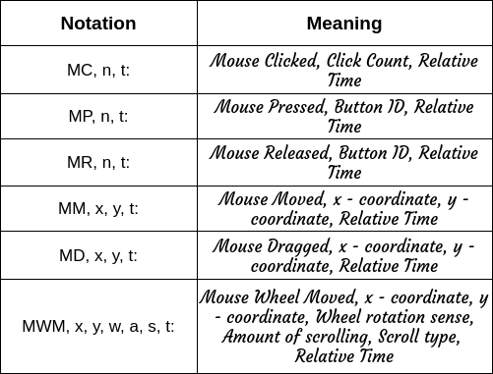
Raw Data

Slide 7
Features
The frequent-behaviour patterns cannot be used directly by a detector or a classifier.
To construct the feature vectors determining user mouse behaviour and validating user identity, we first characterized mouse operations based on two basic physical properties :
Space
Time
The features extracted are:
Statistical features:
Mean
Standard Deviation
Maximum
Range
Critical point count
Pause time, Pauses count, Pause time ratio

Slide 8
Feature Selection
Sequential Feature Selection technique is used for selecting features from a candidate data set.
This Sequential Feature Selector adds (forward selection) or removes (backward selection) features to form a feature subset in a greedy fashion.
At each stage, this estimator chooses the best feature to add or remove based on the cross validation score of an estimator.
Here, we used knn as estimator and reduced to 5 features with scoring as accuracy.

Slide 9
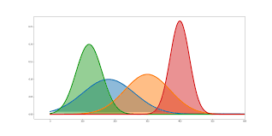
Classifier
Classifier used is Gaussian Mixture Model.
p(X; μ, ∑) = (1/((2π)^{n/2} x (|Σ|^{1/2})))x[exp{-½ (x-μ)^{T} Σ⁻¹ (x-μ)}]
Maximum likelihood estimation method

Slide 10
Gaussian Mixture Models are a powerful clustering algorithm working on the principle of unsupervised learning.
The idea behind clustering is grouping data points together such that each individual cluster holds the most similar points.
Gaussian Mixture Models assume that there are a certain number of gaussian distributions, and each of these distributions represents a cluster. Hence, a Gaussian mixture model tends to group the data points of a single distribution together.
This algorithm is different from k-means clustering in a way that this takes into account the mean as well as the variance of the data.

Slide 11
Results
K th -Fold | Training Accuracy(%) | Testing Accuracy(%)
1st Fold | 96.63016802107306 | 93.62322442801779
2nd Fold | 95.1273505842548 | 97.23906717821176
3rd Fold | 95.25622583977102 | 96.20463681564797
4th Fold | 95.69929020874315 | 95.0859320304987
5th Fold | 97.45703716656706 | 94.07101048526768
Overall Accuracy | 96.0340143640818 | 95.24477418752878

Slide 12
Thank you

